Slide 1

Understanding the Characteristics of Unresolved Matched Records in Capture-Recapture Methodology
Denise A. Abreu
National Agricultural Statistics Service (NASS)
November 2nd, 2021
The findings and conclusions in this presentation are those of the authors and should not be construed to represent any official USDA or U.S. Government determination or policy.

Slide 2
NASS -- U.S. Census of Agriculture
Conducted every 5 years (years ending in 2 and 7)
Count of all U.S. Agricultural operations/Farms
A farm is any place from which $1,000 or more of agricultural products were produced and sold or normally would have been sold during the year
Examples, some special cases:
“Government payment” farms
“Pasture only” farms (at least 100 acres)
Collects information on agricultural operations’ commodities and operator demographics
Notes:
NASS’s Census of Agriculture is conducted every 5 years, in years ending in 2 and 7. It is a count of all U.S. Agricultural operations with $1000 or more in sales. It collects information on agricultural operation’s commodities and operator demographics. It is our only source of uniform, comprehensive agricultural data for every county or county equivalent in the U.S. It beegins with a list-based frame, which we refer to as the Census Mailing List, or CML for short. It is primarily mail data collection.

Slide 3
NASS -- U.S. Census of Agriculture
Only source of uniform, comprehensive agricultural data for every county or county equivalent in the U.S.
Starts with list-based frame
Census Mail List (CML)
Primarily mailout/mailback mode of data collection
Notes:
NASS’s Census of Agriculture is conducted every 5 years, in years ending in 2 and 7. It is a count of all U.S. Agricultural operations with $1000 or more in sales. It collects information on agricultural operation’s commodities and operator demographics. It is our only source of uniform, comprehensive agricultural data for every county or county equivalent in the U.S. It beegins with a list-based frame, which we refer to as the Census Mailing List, or CML for short. It is primarily mail data collection.

Slide 4
Background
In 2012, NASS began to use capture-recapture methodology to adjust for various sources of error
Undercoverage
Not all agricultural operations appear on the CML
Non-response
Not all agricultural operations on the CML respond
Misclassification
Incorrectly classifying farms as non-farms or non-farms as farms

Slide 5
Capture-Recapture Methodology
Dual System Estimation (DSE) is a method of estimating a population (number of farms) using 2 or more capture events
DSE requires two independent data sources:
The Census of Agriculture
The June Area Survey (JAS)
Notes:
To account for these sources of error, we use a method called Dual System Estimation (or Capture Recapture). These methods were used in 2012, as well as by the Census Bureau and in many wildlife population estimates. DSE requires two capture events, or in or case, lists or surveys in order to estimate the total number of farms. The two that we use are the Census of Agriculture and the JAS and ACES (combined as a single dataset). Several assumptions must be made about these surveys in order for our estimates to be valid. 1) The surveys must be independent from one another. That is, if a farm is captured (surveyed and responds) to one survey, it does not affect its likelihood of being captured by the second survey. In our case, we have independence because the JAS is areal and the Census is list-based. The second assumption that we must make is that the proportion of Census farms captured by the JAS is the same as the proportion of U.S. farms captured by the Census.

Slide 6
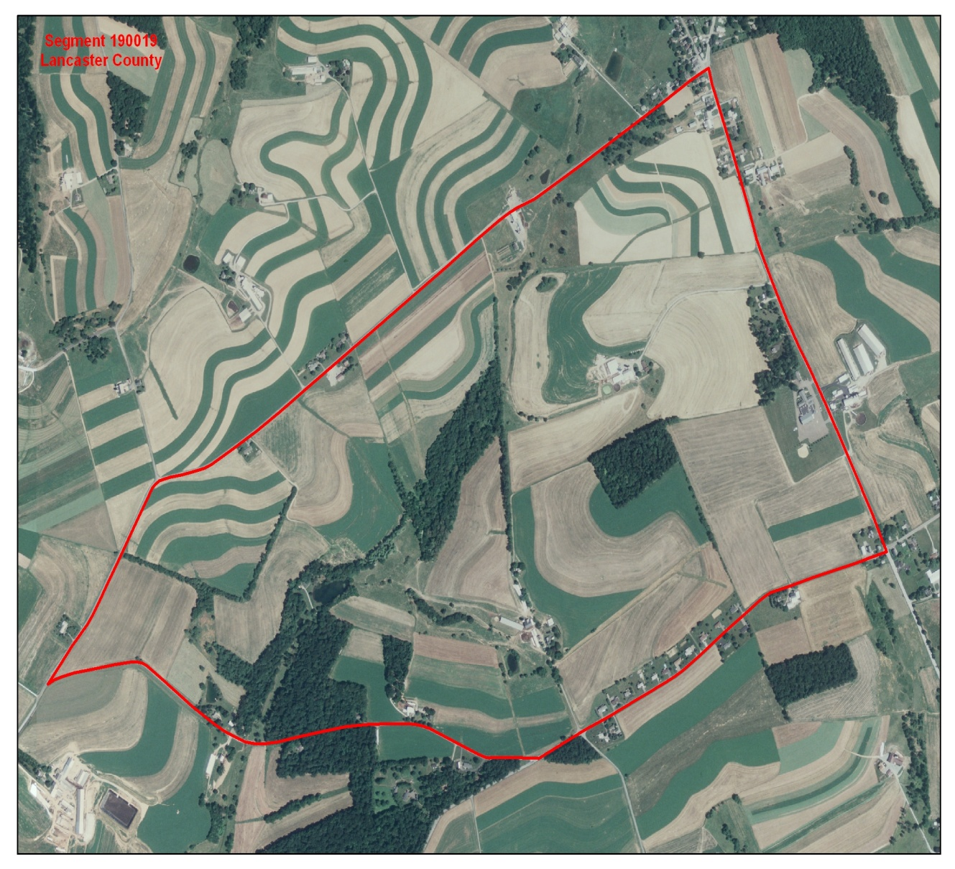
June Area Survey (JAS)
Area-frame based
Conducted annually
Segments of land sampled
Sampled segments divided into tracts representing unique land operating arrangements
In-person interviewers
All tracts pre-screened and classified as:
Agricultural
Non-agricultural
With potential
With unknown potential
With no potential
A
B
C
D
H
G
E
F
Notes:
Here you see an example of a segment in the JAS, which is the sampled piece of land. The sampled segments are divided into tracts that represent unique land operating arrangements. The survey is conducted through in-person interviews. The segments are pre-screened as agricultural or non-agricultural. The non-agricultural tracts are classified as either having potention for agriculture, with unknown potential or with no potential. Then the crop and livestock information is collected only on the operations that are determined to be agricultural.

Slide 7
June Area Survey (JAS)
Crop and livestock information is collected only on the operations classified as agricultural
Agricultural tracts are classified as farms or non-farms based on the farm definition
All non-agricultural tracts are considered non-farms
Measures the incompleteness of the CML
A
B
C
D
H
G
E
F
Notes:
Here you see an example of a segment in the JAS, which is the sampled piece of land. The sampled segments are divided into tracts that represent unique land operating arrangements. The survey is conducted through in-person interviews. The segments are pre-screened as agricultural or non-agricultural. The non-agricultural tracts are classified as either having potention for agriculture, with unknown potential or with no potential. Then the crop and livestock information is collected only on the operations that are determined to be agricultural.

Slide 8
Matching JAS and Census
In order to use DSE, operations from the JAS and CML must be matched
Records in the 2017 JAS sample (120,000) were matched to the 2017 Census (3 Million) using probabilistic record linkage
Records kept:
CML respondent/non-respondent matching JAS tract
Tracts on the JAS that are not on Census Mail List (NML)
Farm status based on the Census and the JAS agree in most cases
Resolved farm status
Some records are identified as
JAS farm vs. Census non-farm
JAS non-farm vs. Census farm
Unresolved farm status

Slide 9
2017 Census and JAS Records with Unresolved Farm Status
 | CML Non-Farm | CML Farm | CML Non-Resp | NML Farm | NML Non-Farm | NML Non-Resp | Total
JAS Non-Farm | 2,126 | 2,669 | 2,009 | 1,049 | 21,315 | 14,528 | 43,696
JAS Farm | 1,788 | 30,564 | 9,864 | 1,423 | 1,149 | 2,323 | 47,111
Total | 3,914 | 33,233 | 11,873 | 2,472 | 22,464 | 16,851 | 90,807
Numbers of records with unresolved farm status are highlighted
An analysis tool was developed for Regional Field Offices (RFOs) to review records with unresolved farm status in an effort to resolve conflicts
Not Reviewed:
CML non-respondents
NML non-respondents

Slide 10
Resolving Farm Status
6,655 records had unresolved farm status
RFOs had 5 possible choices to classify records
Census is Correct
JAS is Correct
Both are Correct
Linkage Incorrect
Unable to determine

Slide 11
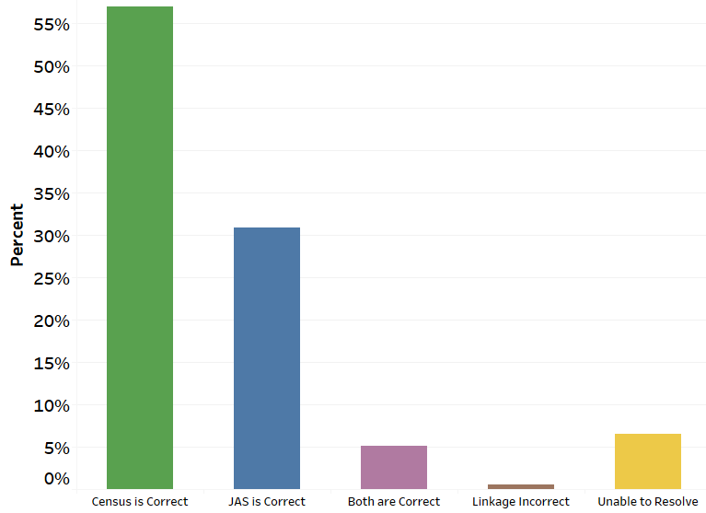
Resolving Farm Status
Notes:
6,221 records resolved through FO review
6.5% of the records could not be resolved and were adjusted for
Less than 1% of the records had incorrect linkages
338 both Census and JAS are correct (5%)
176 were non-farms on the JAS and farms on Census
162 were farms on JAS and non-farms on Census

Slide 12
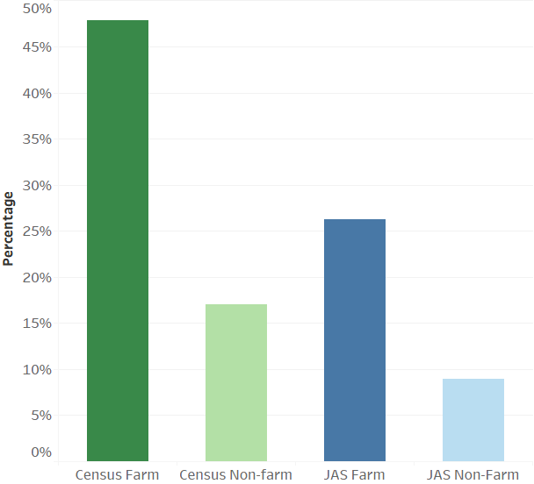
Resolving Farm Status
Notes:
6,221 records resolved through FO review
6.5% of the records could not be resolved and were adjusted for
Less than 1% of the records had incorrect linkages
338 both Census and JAS are correct (5%)
176 were non-farms on the JAS and farms on Census
162 were farms on JAS and non-farms on Census

Slide 13
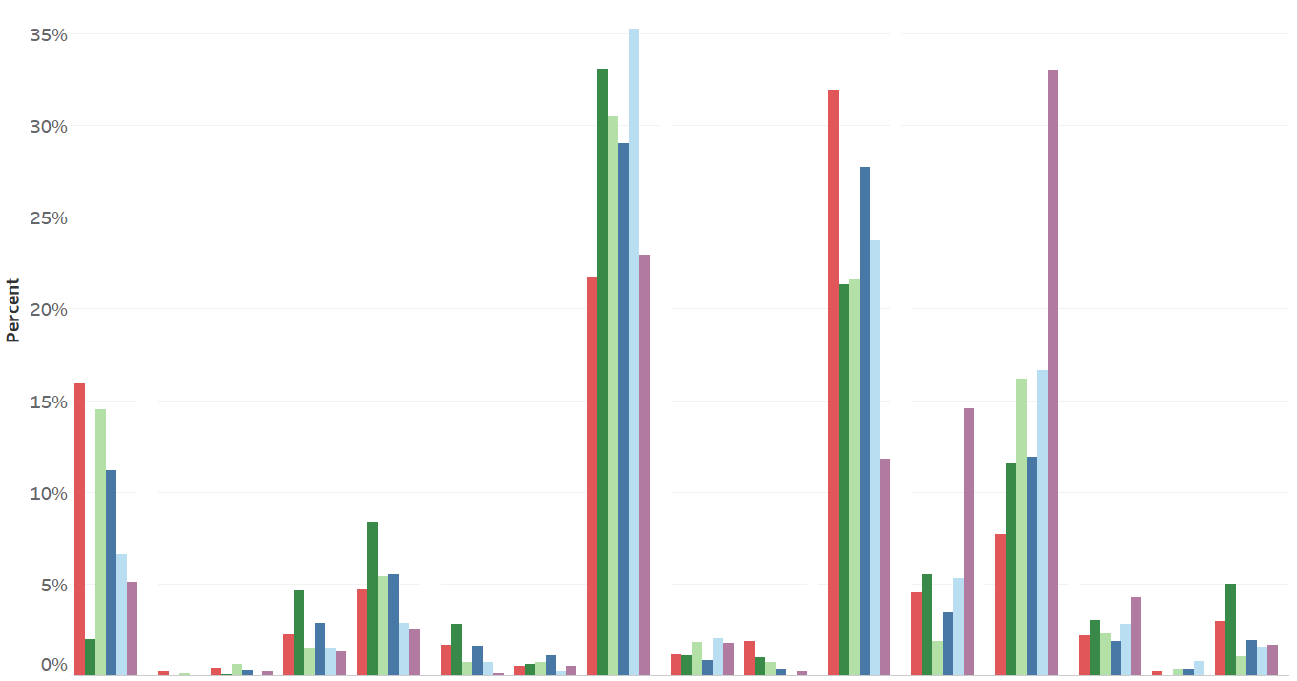
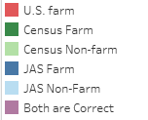
Distribution of Unresolved Farms by Type
Milk
Fruit
Hogs
Cattle
Sheep
Horses
Poultry
Grains
Tobacco
Cotton
Nursery
Aquaculture
Vegetables
Xmas Trees
Other Crops
Other Livestock
8 types of crop farms
8 types of livestock farms

Slide 14
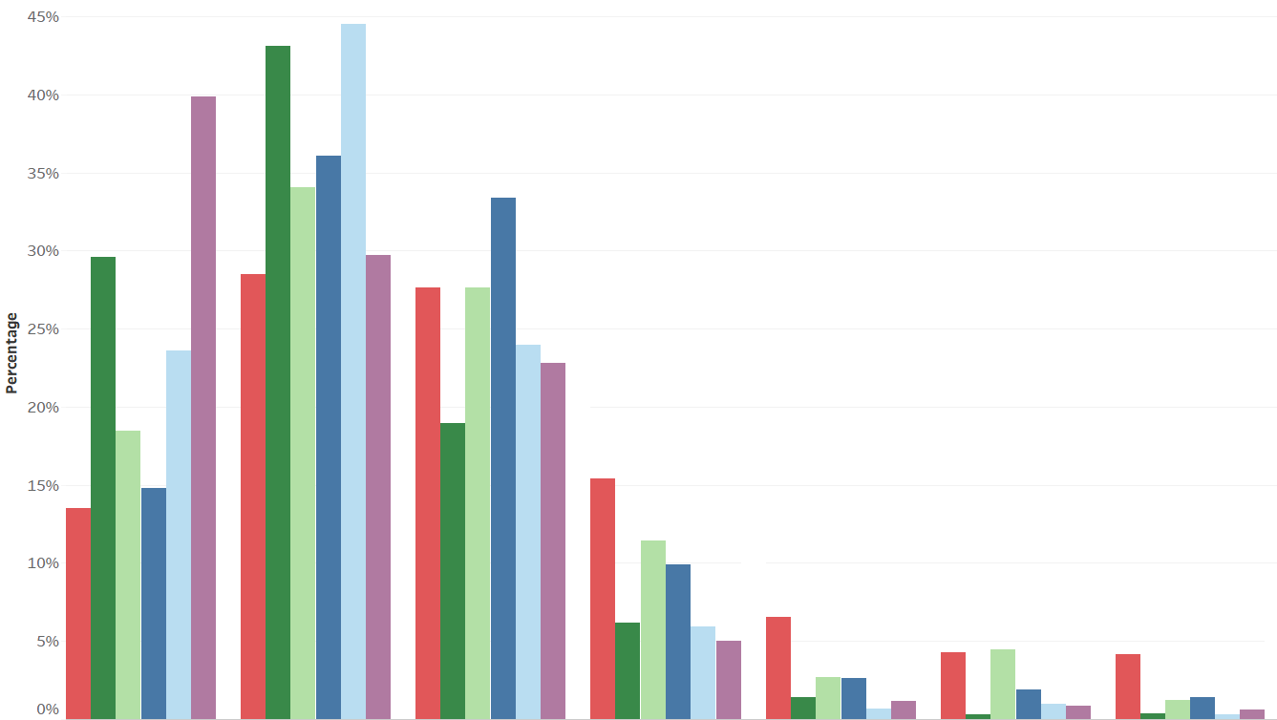
Distribution of Unresolved Farms by Land Area
1 – 9 acres
10 – 49 acres
50 - 179 acres
180 – 499 acres
500 – 999 acres
1,000 – 1,999 acres
2,000 or more acres

Slide 15
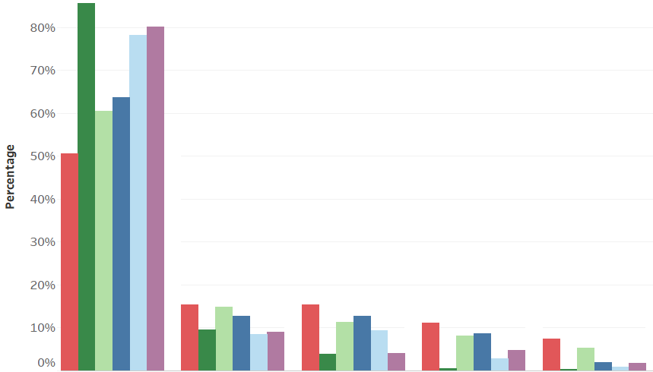
Distribution of Unresolved Farms by Total Value of Production
< $10,000
$10,000 - $25,000
$25,000 - $100,000
$100,000- $500,000
$500,000 or more

Slide 16
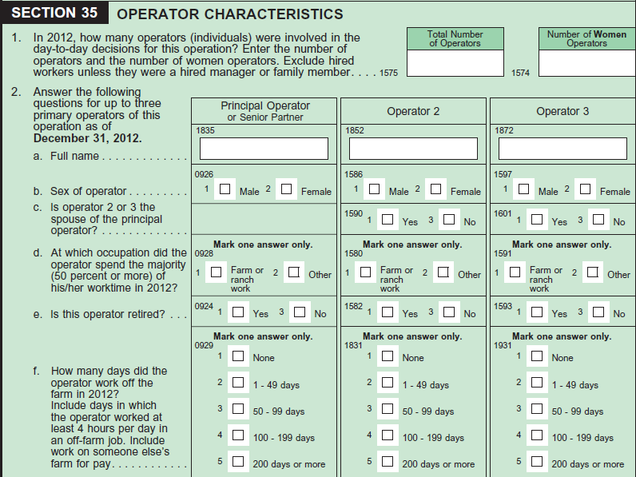
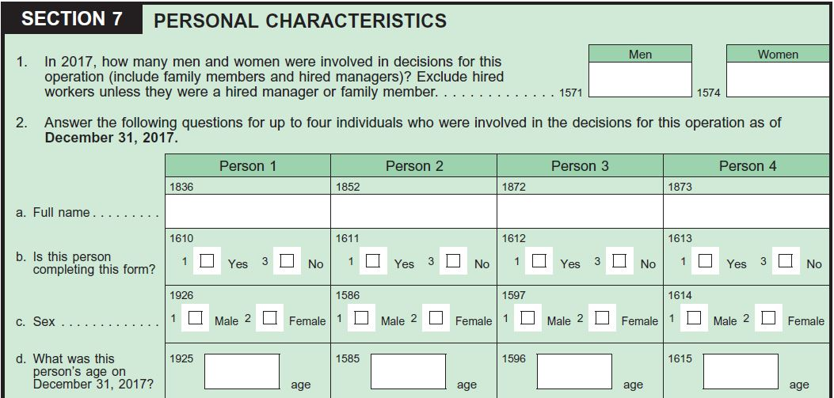
2012 and 2017 Census of Agriculture Demographic Sections
Notes:
The 2017 demographics section of the Census of Agriculture questionnaire was redesigned to allow up to four principal producers per farm

Slide 17
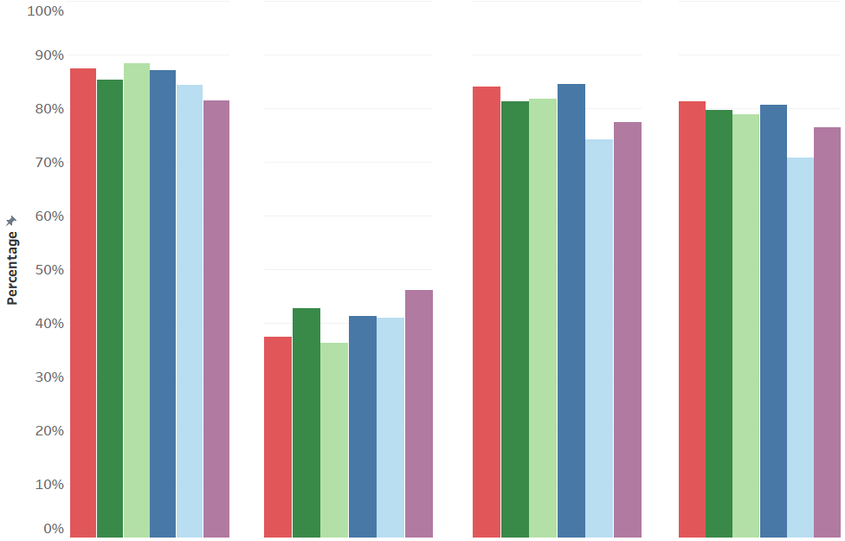

Unresolved Farms with at Least One Principal Producer Displaying Characteristic
Male
Female
Non-Hispanic
White
Notes:
These are percentages of demographics of the primary operators of the farms. They are mostly male, non-hispanic, and white farmers, but these percentages are very similar to the u.s. farms percentages.

Slide 18
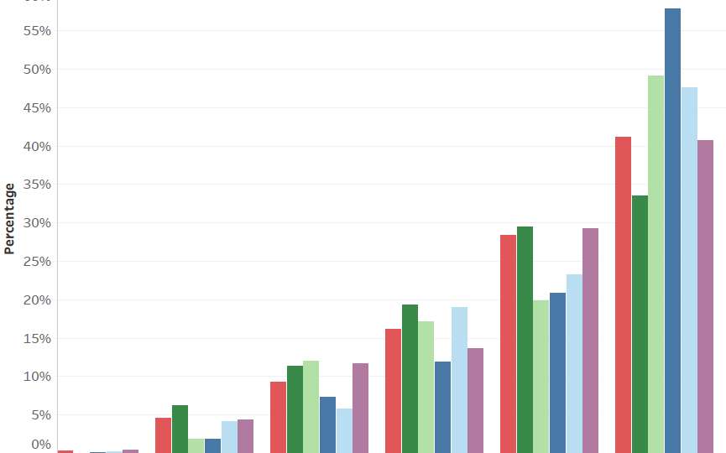
Unresolved Farms with at Least One Principal Producer in the Age Group
< 25
25 - 34
35 - 44
45 - 54
55 - 64
65+
Notes:
This shows the distribution of the age of the primary operators of the farms. The resolved records are a higher percentage of the older farmers.

Slide 19
Conclusions
Census was correct more often than the JAS
Census identified more farms than the JAS
Less than 1% were records with incorrect linkages – accuracy of the matching process

Slide 20
Conclusions
Unresolved farms
Majority were livestock and other crops
Mostly small farms, both in size and sales
JAS identified more medium sized farms
More older farmers identified by the JAS, however more young farmers identified by the Census

Slide 21
Thank you for your attention
Denise A. Abreu
Denise.Abreu@usda.gov

